Slide 1
Event
Change in the state of an object is known as event i.e. event describes the change in state of source.
Events are generated as result of user interaction with the graphical user interface components.
For example, clicking on a button, moving the mouse, entering a character through keyboard, selecting an item from list, scrolling the page are the activities that causes an event to happen.

Slide 2
Types of Event
The events can be broadly classified into two categories:
Foreground Events - Those events which require the direct interaction of user. They are generated as consequences of a person interacting with the graphical components in Graphical User Interface. For example, clicking on a button, moving the mouse, entering a character through keyboard,selecting an item from list, scrolling the page etc.
Background Events - Those events that require the interaction of end user are known as background events. Operating system interrupts, hardware or software failure, timer expires, an operation completion are the example of background events

Slide 3
Event Handling
Event Handling is the mechanism that controls the event and decides what should happen if an event occurs.
This mechanism have the code which is known as event handler that is executed when an event occurs.
Java Uses the Delegation Event Model to handle the events. The java.awt.event package provides many event classes and Listener interfaces for event handling.

Slide 4
Delegation Event Model
This model defines the standard mechanism to generate and handle the events.
It defines standard and consistent mechanisms to generate and process events.
Its concept is quite simple a source generates an event and sends it to one or more listeners.
In this scheme, the listener simply waits until it receives an event. Once an event is received the listener processes the event and then returns.
The advantage of this design is that the application logic that processes events is cleanly separated from the user interface logic that generates those events.
A user interface element is able to “delegate” the processing of an event to a separate piece of code.

Slide 5
Contd…
The Delegation Event Model has the following key participants namely:
Source - The source is an object on which event occurs. Source is responsible for providing information of the occurred event to it's handler. Java provide as with classes for source object.
Listener - It is also known as event handler. Listener is responsible for generating response to an event. From java implementation point of view the listener is also an object. Listener waits until it receives an event. Once the event is received , the listener process the event an then returns.

Slide 6
Contd…
The benefit of this approach is that the user interface logic is completely separated from the logic that generates the event.
The user interface element is able to delegate the processing of an event to the separate piece of code.
In this model, Listener needs to be registered with the source object so that the listener can receive the event notification. This is an efficient way of handling the event because the event notifications are sent only to those listener that want to receive them.

Slide 7
Event Classes
The Event classes represent the event. Java provides us various Event classes.
AWTEvent | It is the root event class for all AWT events. This class and its subclasses supercede the original java.awt.Event class.
ActionEvent | The ActionEvent is generated when button is clicked or the item of a list is double clicked.
InputEvent | The InputEvent class is root event class for all component-level input events.
KeyEvent | On entering the character the Key event is generated.
MouseEvent | This event indicates a mouse action occurred in a component.
TextEvent | The object of this class represents the text events.
WindowEvent | The object of this class represents the change in state of a window.

Slide 8
Steps to perform Event Handling
Following steps are required to perform event handling:
Implement the Listener interface and overrides its methods
Register the component with the Listener(ActionListener, MouseListener, KeyListener, WindowListener)

Slide 9
Swing
It is used to create window-based applications.
It is built on the top of AWT (Abstract Windowing Toolkit) API and entirely written in java.
It acts as replacement of AWT API as it has almost every control corresponding to AWT controls.
Java Swing provides platform-independent and lightweight components
The javax.swing package provides classes for java swing API such as JButton, JTextField, JTextArea, JRadioButton, JCheckbox, JMenu, JColorChooser etc.

Slide 10
Contd…
Swing API is set of extensible GUI Components to ease developer's life to create JAVA based Front End/ GUI Applications.
Swing component follows a Model-View-Controller architecture to fulfill the following criteria’s.
A single API is to be sufficient to support multiple look and feel.
API is to model driven so that highest level API is not required to have the data.
API is to use the Java Bean model so that Builder Tools and IDE can provide better services to the developers to use it.

Slide 11
Swing features
Light Weight - Swing component are independent of native Operating System's API as Swing API controls are rendered mostly using pure JAVA code instead of underlying operating system calls.
Rich controls - Swing provides a rich set of advanced controls like Tree, TabbedPane, slider, color picker, table controls.
Highly Customizable - Swing controls can be customized in very easy way as visual appearance is independent of internal representation.
Pluggable look-and-feel- SWING based GUI Application look and feel can be changed at run time based on available values.

Slide 12
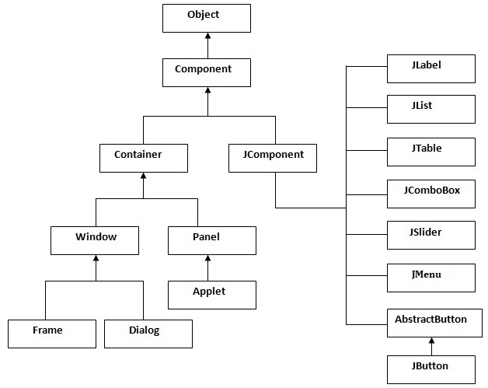
Hierarchy of Java Swing classes

Slide 13
Commonly used Methods of Component class
Method | Description
public void add(Component c) | add a component on another component.
public void setSize(int width,int height) | sets size of the component.
public void setLayout(LayoutManager m) | sets the layout manager for the component.
public void setVisible(boolean b) | sets the visibility of the component. It is by default false.

Slide 14
There are two ways to create a frame:
By creating the object of Frame class (association)
By extending Frame class (inheritance)

Slide 15
Java AWT (Abstract Window Toolkit)
Java AWT is an API to develop GUI (Graphical User Interface) or window-based application in java.
Java AWT components are platform-dependent i.e. components are displayed according to the view of operating system. AWT is heavyweight i.e. its components uses the resources of system.
It offers user interaction via some graphical components
The java.awt package provides classes for AWT api such as TextField, Label, TextArea, RadioButton, CheckBox, Choice, List etc.

Slide 16
Difference between AWT and Swing
Java AWT | Java Swing
AWT components are platform-dependent. | Java swing components are platform-independent.
AWT components are heavyweight. | Swing components are lightweight.
AWT doesn't support pluggable look and feel. | Swing supports pluggable look and feel.
AWT provides less components than Swing. | Swing provides more powerful components such as tables, lists, scrollpanes, colorchooser, tabbedpane etc.
AWT doesn't follows MVC(Model View Controller) where model represents data, view represents presentation and controller acts as an interface between model and view. | Swing follows MVC.

